Slide 1
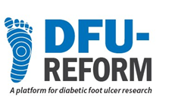

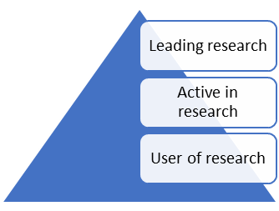
Research Leader –A journey
SENSE
Dr Richard Collings
Interim Head of Podiatry and Orthotic services (TSDFT)
Honorary Clinical Fellow (University of Plymouth)

Slide 2

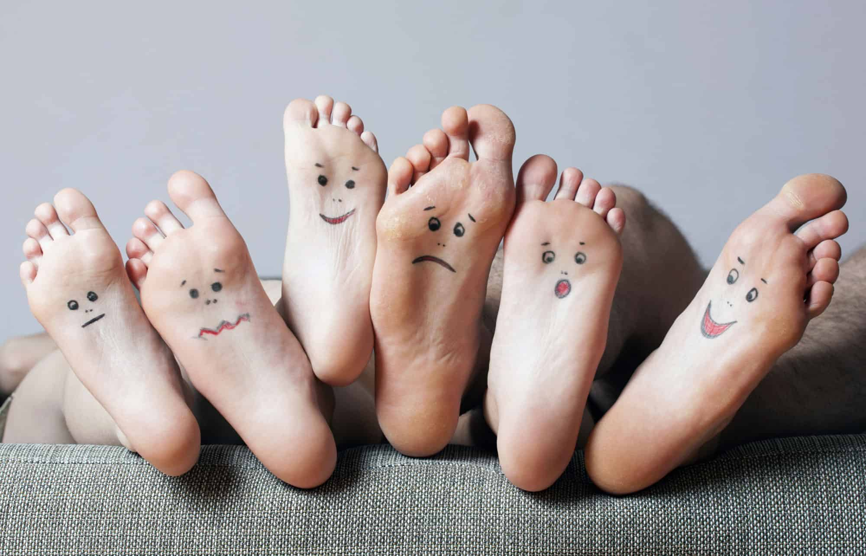




Career journey to date:
Early years
Postman
2017-2021
2021-2024
Operational Lead
Clinical
Research
Teach
Next?
2025+
2007-2017
Podiatry BSc/MSc
Doctoral award
+
Pod role

Slide 3
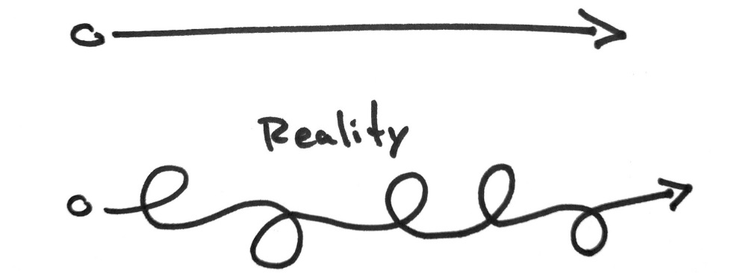
Opportunity

Slide 4

Pressure
Pressure = measure of how MUCH force is acting on an area
‘NICE’ /IWGFD ‘assessing for high pressure areas’…. (prominent areas, callus, corn)
high pressures to risk of DFU or enhance recovery from DFU
Weightbearing is the mechanism of injury

Slide 5
PhD –Insoles to ease plantar pressure in DPN
Diabetes
Neuropathy
Altered foot structure
Elevated plantar pressure
Biomechanical factors
in the aetiology of
neuropathic foot
ulceration
Tissue Stress
Callus
Injury and Ulceration
(Adapted from Cavanagh 1995)
Notes:
Berlowitz DR, Brienza DM. Are all pressure ulcers the result of deep tissue injury? A review of the literature. Ostomy Wound Manage. 2007;53(10):34-8.
Bader DL, Worsley PR. Technologies to monitor the health of loaded skin tissues. Biomed Eng Online. 2018;17(1):40.

Slide 6
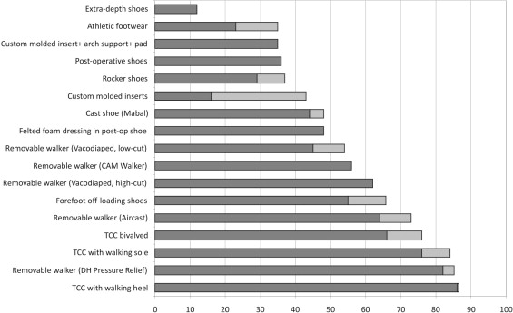
Cavanagh & Bus (2010) Off-loading the diabetic foot for ulcer prevention and healing

Slide 7
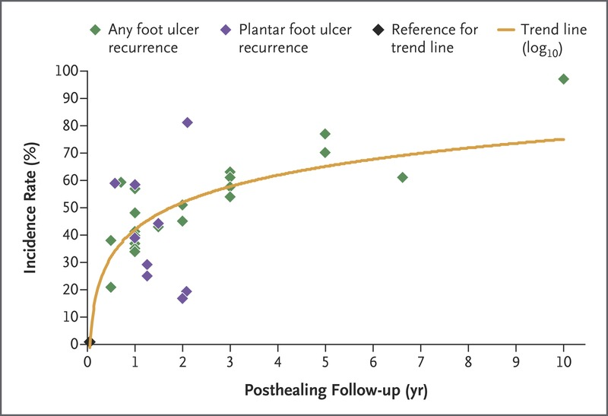
Armstrong, Boulton, Bus(2017)Diabetic Foot Ulcers and Their Recurrence

Slide 8
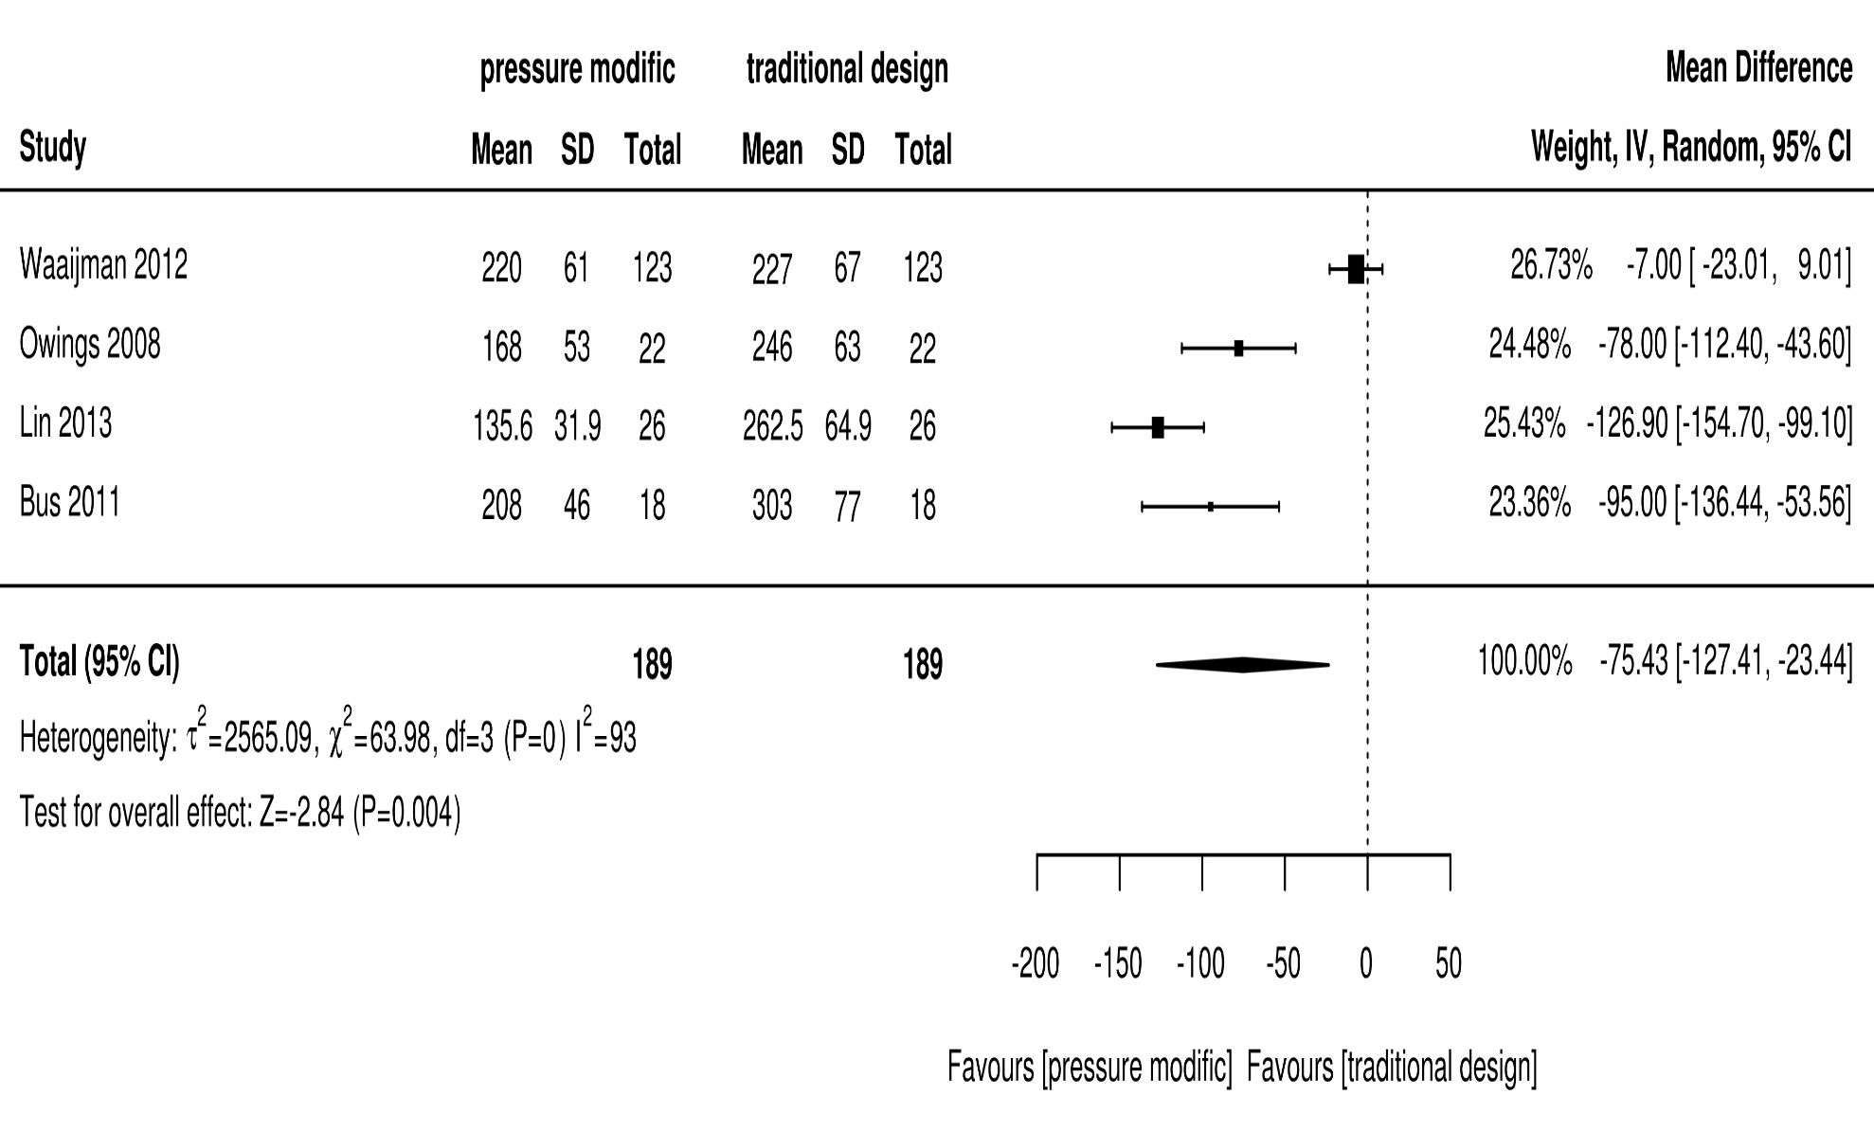
Pedobarography designed
Collings et al., (2020)

Slide 9
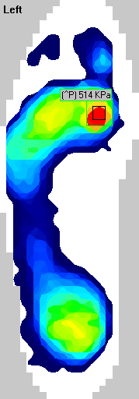
Patient referred after healed ulcer left 1st MTPJ
6 months in situ, healed with TCC
Pes cavus, plantarflexed 1st ray, stiffening tissues
PP=514kPa

Slide 10
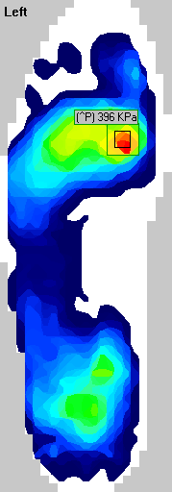
1st modification
ROI= 396KPa

Slide 11
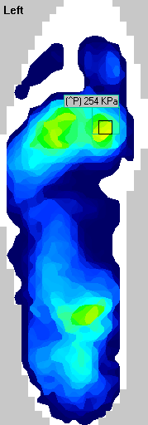
2nd modification
ROI= 254KPa

Slide 13
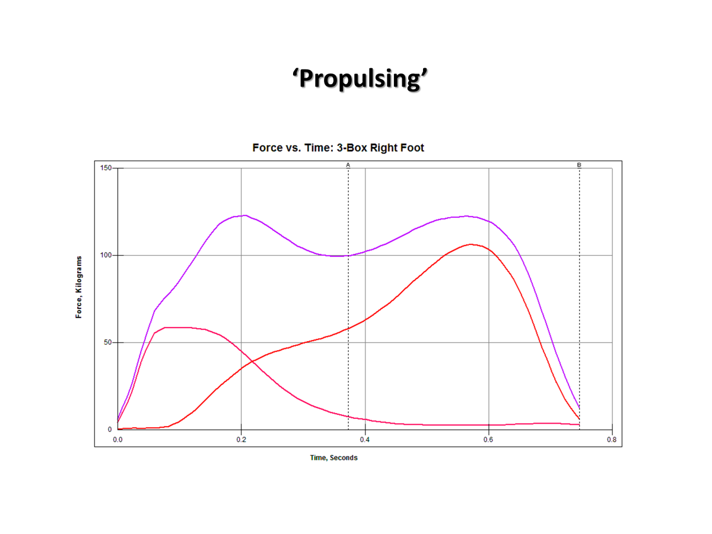
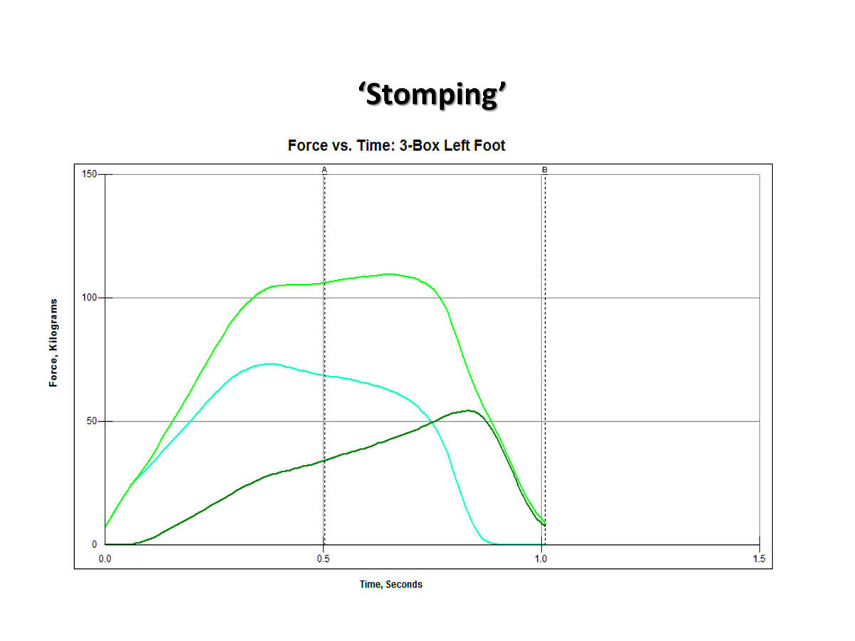
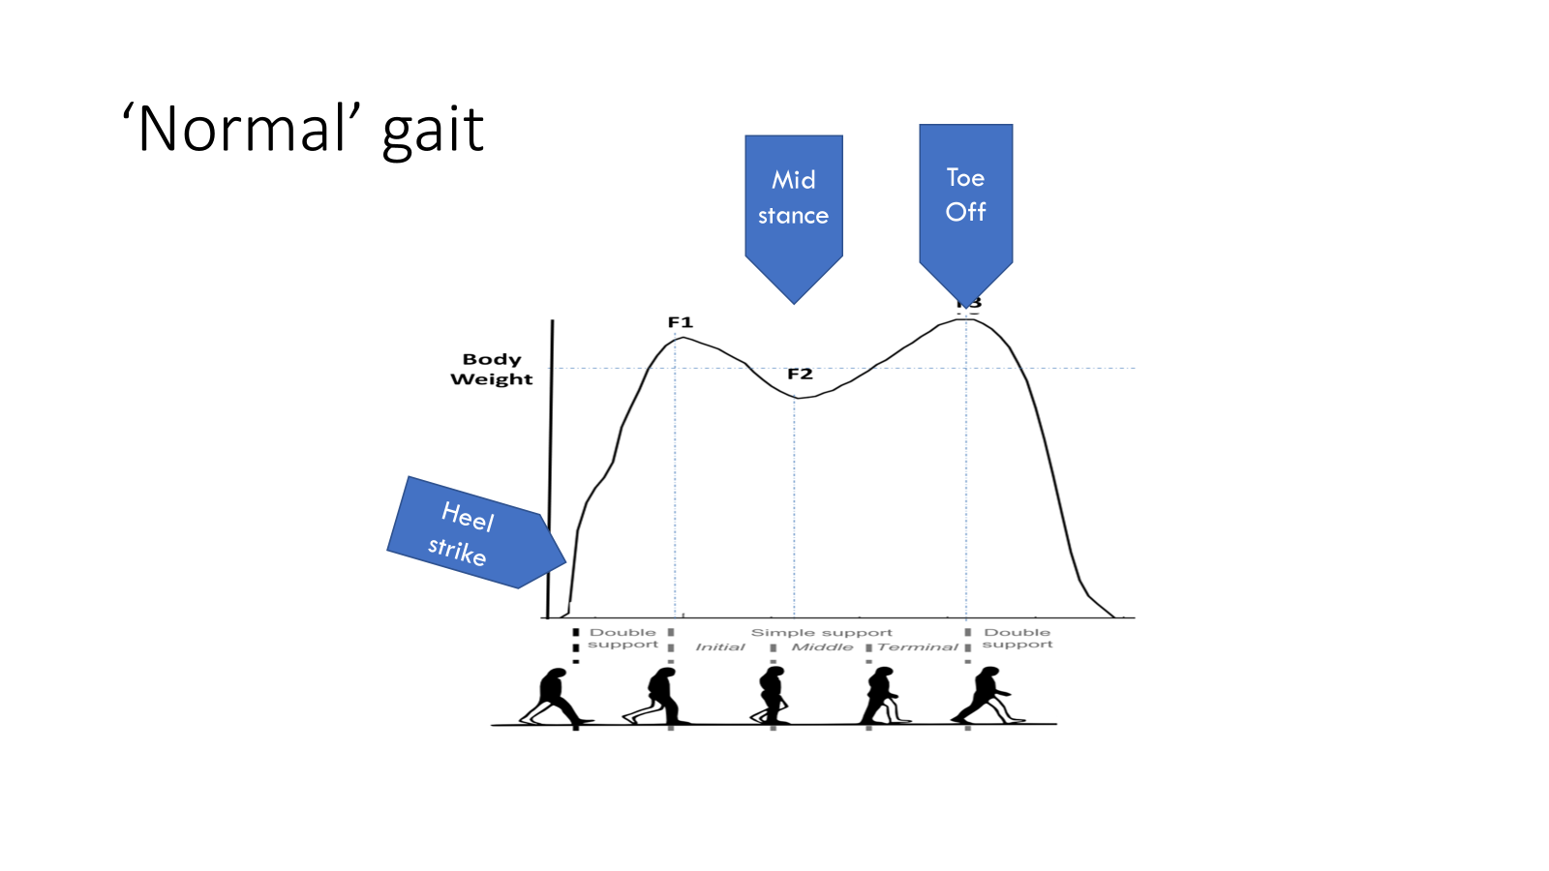
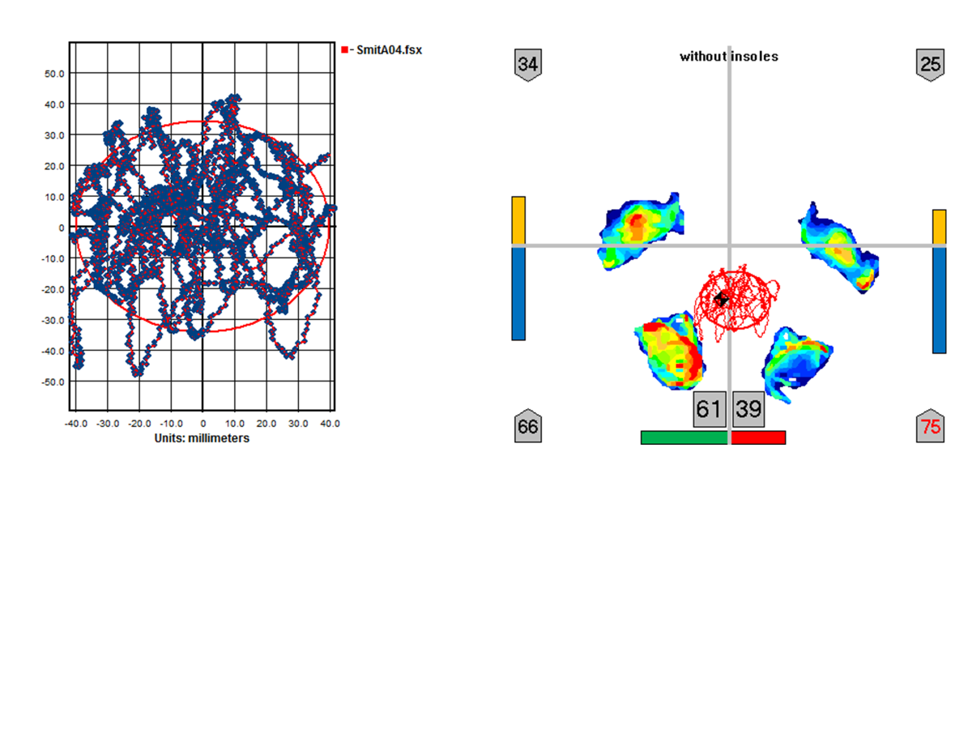
‘Variable’ gait

Slide 14
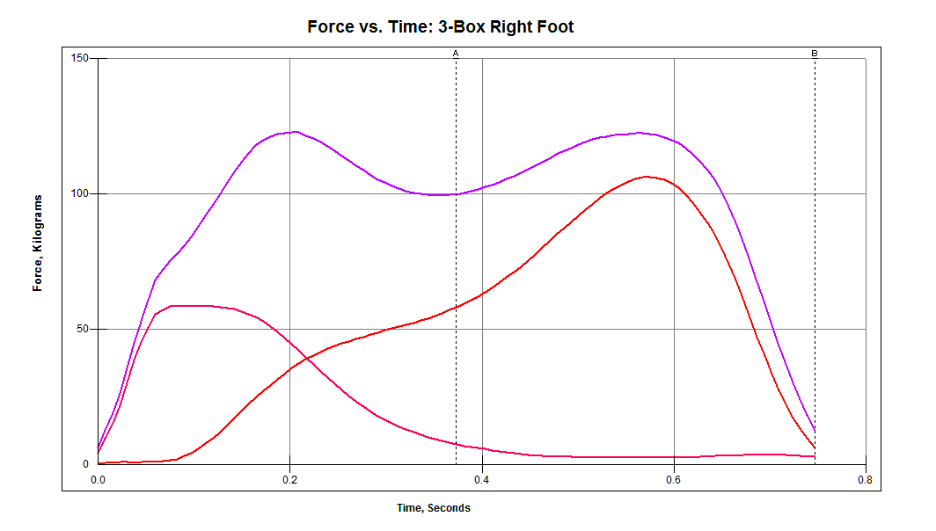
‘Propulsing’

Slide 15
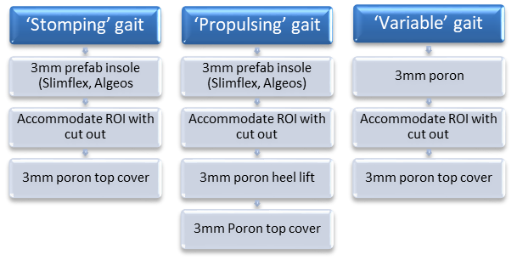

Slide 16
Post randomisation (MPPP % change) | Active control insole | Optimised insole
ROI-1 | -20.1% | -36.9%
ROI-2 | -7.4% | -36.6%
ROI-3 | -29.9% | -27.7%
Collings R, Freeman J, Latour JM, Hosking J, Paton J. Insoles to ease plantar pressure in people with diabetes and peripheral neuropathy: a feasibility randomised controlled trial with an embedded qualitative study. Pilot Feasibility Stud. 2023 Feb 3;9(1):20. doi: 10.1186/s40814-023-01252-y. PMID: 36737812; PMCID: PMC9896776.
Notes:
1 immediately after issue, MPPP reduced across all ROI’s

Slide 17
Ulcer prevention
Insole provision
Footwear provision
Callus debridement
Vascular assessment
Metabolic control
Education
Notes:
I am not suggesting that providing all people with diabetes with the perfect insole will reduce amputation rates. And its important that we acknowledge that foot ulcer prevention is complex and multifactorial.
To have real impact on health outcomes you need input from the whole foot protection team, however biomechanics and insole provision is one important aspect of that foot prevention strategy and that is what this presentation will now focus on.
Prevention and treatment of ulceration is complex and multifactorial.
Insoles
Footwear
Metabolic control
Education
Callus debridement
Vascular control

Slide 18

Current ventures

Slide 19
Strategic influence
CAHPR Vice-chair + Strategy committee
National - Podiatry research committee
Torbay RDI committee, Research council, Clinical school

Slide 20
Mentorship
Lead Co-ordinator National research champion network (CAHPR/NIHR)
REDUCE Podiatry research co-lead
Mentor/supervise Internships, Fellowships and PhD students
Supervise International students Advanced Practice MSc
Teach/peer review

Slide 21
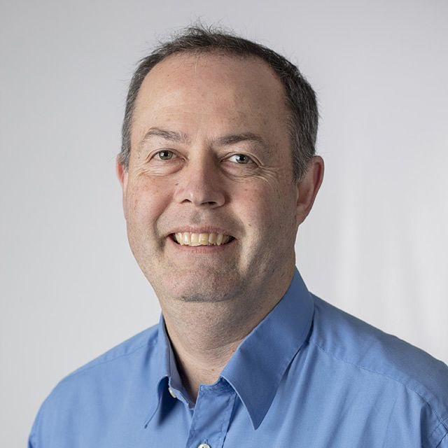
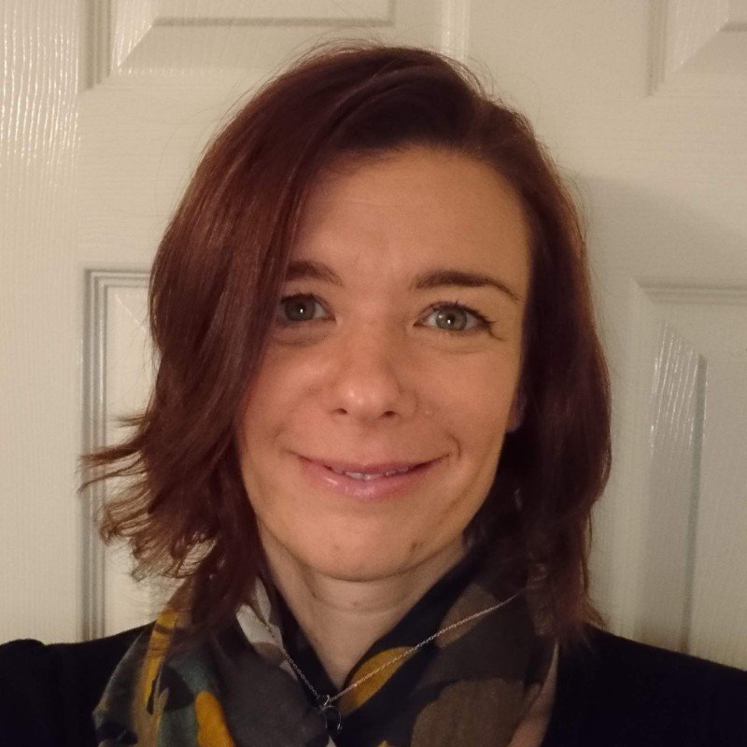
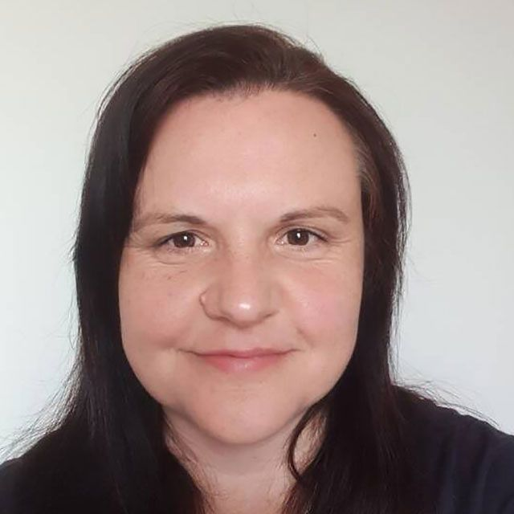
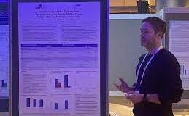
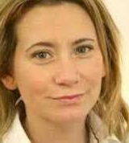

Podiatry Research
18 publications
£500k in funding awards
2 Phd, 2MSc, 3 Internships, 3 pre-doc, 1 post-doc
International and National conference presentations
PI’s in 4 National research studies, 5 EOI’s
Collaborations BEUP, University of Plymouth, University of Exeter, Leeds

Slide 22

Leading research
Active in research
User of research

Slide 23
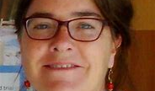
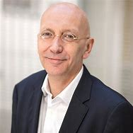
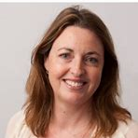
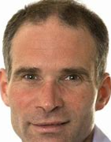
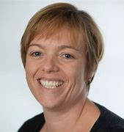
Academic support network

Slide 24


Slide 25
richard.collings@nhs.net

