Slide 1
The DFU Core Outcome Set - why and how was it developed, and what does it mean for study design?
Alex Staniszewska
(on behalf of the DFU COS Study collaborators)
Specialty Registrar and Research Fellow in Vascular Surgery
Translational Health Sciences
University of Bristol

Slide 2






Diabetes-related foot ulceration research challenges
537 million people with diabetes worldwide
33% develop foot ulceration
Most ulcers heal with expert multidisciplinary care
  Up to 32x risk of major lower limb amputation
      >80% preceded by an ulcer
Foot ulceration
Significant disability and economic burden

Slide 3




Diabetes-related foot ulceration research challenges
Selection of the most effective evidence-based interventions
Improved patient outcomes
Improved pathways of care
Lack of homogeneous outcome reporting across interventions = critical limitation in diabetic foot research
Cochrane and other systematic reviews
Similar issues in other disease processes

Slide 4

Tackling heterogeneity in outcome reporting
Core Outcome Measures in Effectiveness Trials Initiative
Aim to standardise outcome reporting across studies = direct comparison of health care interventions
Rigorous methodology for development of a disease- or treatment-specific core outcome set
Core Outcome Set (COS)
Agreed standardised set of outcomes that should be measured and reported,
as a minimum, in all clinical trials in specific areas of health or health care
262 COS have been developed and implemented into research practice
COS for studies on rheumatoid arthritis
158 RCTs

Slide 5
Tackling heterogeneity in diabetes-related foot ulceration research
Study aim
Interdisciplinary and international effort to develop a COS for studies assessing the effectiveness and safety of interventions to treat diabetes-related foot ulceration
Scope of the DFU COS
For use in all trials and clinical research studies evaluating safety and effectiveness of all potential interventions for diabetes-related foot ulceration in adults aged ≥16 years with a diagnosis of diabetes mellitus

Slide 6
DFU COS development
COMET Framework
Core Outcome Measures in Effectiveness Trials Initiative
Phase I – Systematic review
Phase II – Patient interviews
Phase III – Delphi process
Phase IV – Steering group outcome rationalisation
Phase V – Consensus meeting

Slide 7


DFU COS development
Phase I – Systematic review
Aim: To generate a longlist of candidate outcomes for potential inclusion in DFU COS
Prospective studies assessing treatments for diabetes-related foot ulceration involving adult populations:
English language
Published between January 2016 and March 2019
Studies purely evaluating cost-effectiveness, preventive interventions, having less than half of participants with a diagnosis of diabetes, or only involving patients with Charcot neuroarthropathy of the foot were excluded
114 studies
714 distinct verbatim outcomes
95 unique merged outcomes

Slide 8
DFU COS development
Phase II – Patient interviews (September 2022 to March 2023)
Aim: To capture any additional outcomes considered to be important by patients which had not been identified in the systematic review
Semi-structured interviews using a topic guide developed in collaboration with a qualitative researcher
18 patients (17 men, median age 69) identified through diabetic foot clinics in multidisciplinary diabetic foot clinics within Bristol, Bath and Weston Vascular Network :
Type of treatment received (N patients)
Surgical debridement (N=4)
Revascularisation (N=9)
Minor amputation (N=8)
Major amputation (N=2)
Orthopaedic reconstructive surgery (N=3)
Wound care and offloading only (N=4)
8 additional outcomes
Wound bleeding
Foot swelling
Weight loss
Requirement for foot elevation
Reduction in cigarette smoking
Psychological impact on partner
Complications of debridement
Complications of plaster casting

Slide 9




DFU COS development
Phase III – Delphi Process (May–December 2023)
Aim: To select critical outcomes to be considered for inclusion in the DFU COS
The 103 unique outcomes = systematic review (N=95) and patient interviews (N=8) Delphi survey
Delphi Survey delivered on platform
Anonymous link to Round 1 was distributed through:
1) Professional societies with an interest in diabetes-related foot disease
3) Patients attending MDFC in Bristol, Bath and Weston Vascular Network
2) Social media

Slide 10
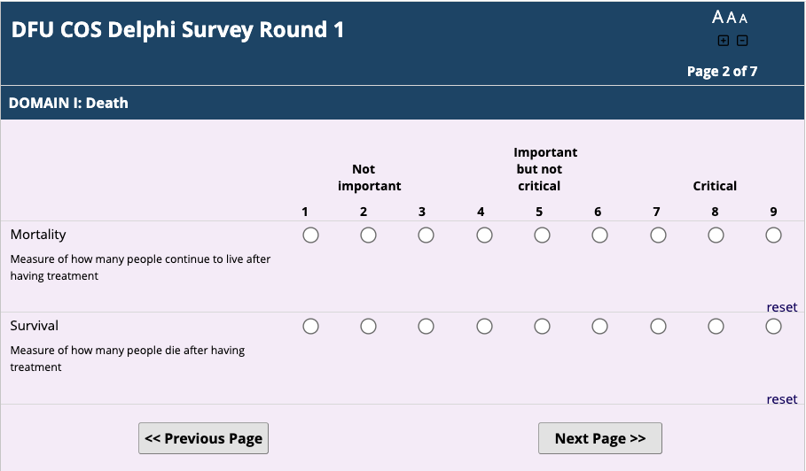
DFU COS development
Phase III – Delphi Process
Delphi Survey – Round 1
Outcomes divided into 5 core areas using COMET taxonomy:
(death, physiological/clinical, life impact, resource use, and adverse events)
Long-list of outcomes rated by patients and experts using a 9-point Likert scale
Consensus criteria:
Statements for inclusion:
Rated 7,8 and 9 >70%
Statements for exclusion:
Rated 1,2 and 3>70%
No consensus:
Everything else
For consideration in COS
Outcome discarded
Reprioritised in Round 2

Slide 11
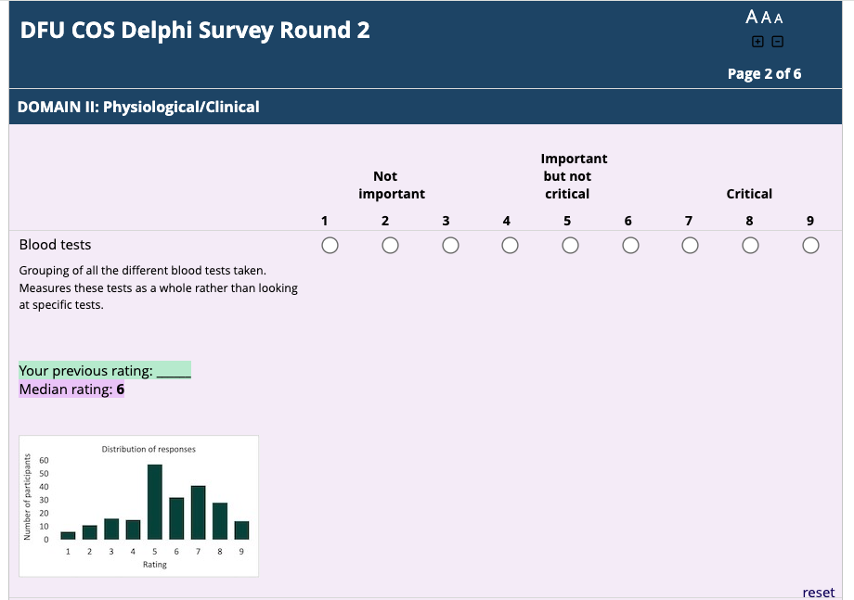

DFU COS development
Phase III – Delphi Process
Aim: To select critical outcomes to be considered for inclusion in the DFU COS
Delphi Survey – Round 2
Outcomes without consensus reprioritised
Consensus criteria:
Statements for inclusion:
Rated 7,8 and 9 >70%
Statements for exclusion:
Rated 1,2 and 3>70%
No consensus:
Everything else
For consideration in COS
Outcome discarded
For discussion in the consensus meeting

Slide 12
DFU COS development
Phase III – Delphi Process
 | Round 1 N= 336 | Round 2 N= 176
Number of participants
Healthcare professionals | 281 (84) | 152 (86)
Patients | 55 (16) | 24 (14)
Clinical role of healthcare professionals
Doctor | 114 (41) | 65 (43)
Podiatrist | 133 (47) | 69 (45)
Nurse | 12 (4) | 8 (5)
Other | 22 (8) | 10 (7)
Specialty of healthcare professionals
Vascular Surgery | 72 (26) | 43 (28)
Orthopaedics | 13 (5) | 4 (3)
Diabetes and Endocrinology | 124 (44) | 74 (49)
Other | 72 (26) | 31 (20)
Seniority of participating doctors
Consultants | 86 (75) | 51 (79)
Staff grades | 10 (9) | 4 (6)
Registrars | 18 (16) | 10 (15)
Years of clinical experience
<5 | 27 (10) | 10 (7)
5-10 | 52 (19) | 27 (18)
11-20 | 82 (29) | 51 (34)
>20 | 120 (43) | 64 (42)
Delphi Survey – Results

Slide 13
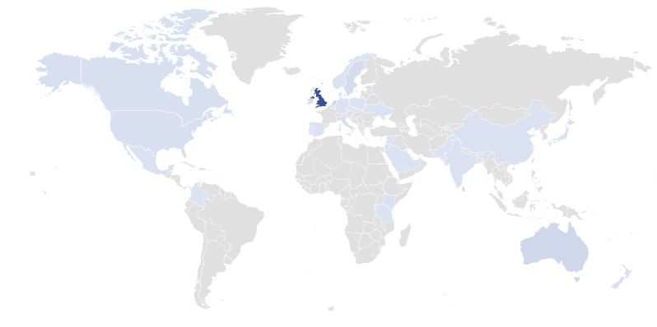

DFU COS development
Phase III – Delphi Process
Responses from 33 countries across 6 continents
1 179
Number of responses
Distribution of responses to the first round of the Delphi survey by country.
A similar distribution was observed in the second round.

Slide 14
DFU COS development
Phase III – Delphi Process
Delphi Round 1
N= 103
Not important outcomes
N= 0
Outcomes without consensus
N= 56
Critical outcomes
N= 47
Delphi Round 2
N= 56
Not important outcomes
N= 0
Outcomes without consensus
N= 40
Critical outcomes
N= 16

Slide 15
DFU COS development
Phase IV – Steering group outcome rationalisation
Unexpectedly high number of outcomes being considered as critical (N=63) or lacking consensus (N=40)
Steering group rationalised the list of outcomes:
Aim: To ensure that COS is relevant, practical and feasible
Reason for exclusion from discussion in consensus meeting | N of outcomes
Captured in other outcomes Forefoot amputation | 12
Not universally relevant to all patients Procedural success | 11
Not specific enough for inclusion in the COS Measures of response to treatment | 7
Not a true outcome measure Measurement of limb perfusion | 5
Treatment and not outcome Offloading | 6
Number of candidate outcomes after rationalisation:
22 critical
15 without consensus
Rationalisation process for outcomes ranked as critical in the Delphi Process.
Similar process undertaken for outcomes without consensus

Slide 16
DFU COS development
Phase V – Consensus meeting
Aim: To ratify the final COS
Online consensus meeting attended by:
  5 patient representatives
  23 international experts on diabetes-related foot disease and members of IWGDF:
Specialty | Number
Diabetologists | 4
Podiatrists | 4
Vascular surgeons | 8
Orthopaedic surgeons | 2
Movement scientists | 2
Plastic surgeons | 1
Infectious diseases physicians | 1
Trial methodologist | 1
United Kingdom
USA
Australia
Netherlands
Portugal

Slide 17
DFU COS development
Phase V – Consensus meeting
37 out of 103 longlisted outcomes (22 ranked as critical and 15 without consensus) were discussed and voted on in the consensus meeting
Outcomes ranked as critical in the Delphi process | Participants voting for exclusion (rated 1-3) (%) |  | Participants voting as no consensus (rated 4-6) (%) |  | Participants voting for inclusion (rated 7-9) (%)
 | Delphi | Consensus meeting | Delphi | Consensus meeting | Delphi | Consensus meeting
Mortality | 4 | 0 | 15 | 0 | 81 | 100
Wound healing | 0 | 0 | 9 | 4 | 91 | 96
Major amputation | 2 | 5 | 5 | 0 | 93 | 95
Minor amputation | 2 | 4 | 13 | 4 | 85 | 91
Ulcer recurrence | 0 | 0 | 11 | 17 | 89 | 83
Time to healing | 1 | 0 | 14 | 17 | 85 | 83
Infection | 1 | 8 | 9 | 8 | 90 | 83
New ulceration | 1 | 5 | 10 | 18 | 89 | 77
Health-related quality of life | 1 | 4 | 28 | 24 | 71 | 72
Osteomyelitis | 0 | 8 | 11 | 21 | 89 | 71
Hospital admission | 2 | 0 | 19 | 35 | 79 | 65
Revascularisation | 1 | 12 | 10 | 28 | 89 | 60
Global quality of life | 1 | 12 | 16 | 32 | 83 | 56
Cardiovascular events | 3 | 12 | 22 | 35 | 75 | 54
Ambulatory status | 2 | 17 | 22 | 35 | 76 | 48
Pain | 2 | 15 | 25 | 42 | 73 | 42
Change in ulcer dimensions | 1 | 8 | 20 | 54 | 79 | 38
Acute kidney injury | 8 | 15 | 20 | 50 | 72 | 35
Need for antimicrobial treatment | 3 | 38 | 15 | 33 | 82 | 29
Need for additional surgical procedures | 2 | 28 | 14 | 44 | 84 | 28
Degree of granulation tissue | 5 | 25 | 25 | 54 | 70 | 21
Tolerability | 1 | 24 | 13 | 56 | 86 | 20
10 voted as critical

Slide 18
DFU COS development
Phase V – Consensus meeting
37 out of 103 longlisted outcomes (22 ranked as critical and 15 without consensus) were discussed and voted on in the consensus meeting
Outcomes without consensus after the Delphi process | Participants voting for exclusion (rated 1-3) (%) |  | Participants voting as no consensus (rated 4-6) (%) |  | Participants voting for inclusion (rated 7-9) (%)
 | Delphi | Consensus meeting | Delphi | Consensus meeting | Delphi | Consensus meeting
Length of hospital stay | 3 | 19 | 30 | 58 | 67 | 23
Falls | 10 | 32 | 53 | 52 | 37 | 16
Cerebrovascular events | 5 | 32 | 35 | 56 | 60 | 12
Requirement for social care | 4 | 50 | 28 | 42 | 68 | 8
Foot fracture | 2 | 56 | 29 | 40 | 69 | 4
Levels of exudate | 6 | 68 | 32 | 28 | 62 | 4
Psychological impact on partner | 6 | 68 | 38 | 28 | 56 | 4
Sleep disturbance | 9 | 65 | 43 | 31 | 48 | 4
Foot swelling | 8 | 76 | 28 | 24 | 64 | 0
Odour | 13 | 81 | 42 | 19 | 45 | 0
Wound bleeding | 8 | 81 | 48 | 19 | 44 | 0
Anaemia | 12 | 88 | 57 | 12 | 31 | 0
Respiratory complications | 13 | 88 | 58 | 12 | 30 | 0
Weight loss | 16 | 96 | 64 | 4 | 20 | 0
Development of cataract | 41 | 96 | 51 | 4 | 8 | 0
0 voted as critical

Slide 19
DFU COS
The consensus meeting participants unanimously ratified the final COS for studies assessing interventions for diabetes-related foot ulceration by the end of the meeting and agreed to include eight outcomes:
Core Outcome Set for studies assessing treatments for diabetes-related foot ulceration
Wound healing
Time to healing
New/recurrent ulceration
Infection
Major amputation (above the ankle level)
Minor amputation (below the ankle level)
Health-related quality of life
Mortality
Set of outcomes that should be measured and reported, as a minimum,
in all studies assessing treatments for diabetes-related foot ulceration

Slide 20

DFU COS – Next Steps
Development of a strategy to increase visibility and uptake of the DFU COS
Development of a Core Descriptor Set:
Agreed set of baseline patient characteristics which should be reported, as a minimum by each study assessing DFU interventions
Systematic review and Delphi Round 1 completed

Slide 21
DFU COS Study Group
Diabetes and Endocrinology
Plastic Surgery
Patient representatives
Frances Game
Ketan Dhatariya
Michael Edmonds
Emma J. Hamilton
Lawrence A. Lavery
Linda Brodie
Janet Harford
Brenda Riley
Sarah Parsons
Michael Vernon
Trials methodology
Jane Nixon
Orthopaedic Surgery
Human Movement Science
Dane K. Wukich
Venu Kavarthapu
Vascular Surgery
Sicco A. Bus
Jaap van Netten
Robert J. Hinchliffe
David Russell
Joseph L. Mills
Robert Fitridge
Jayer Chung
Aleksandra Staniszewska
Christopher Ashmore
Joseph Shalhoub
George Dovell
Vascular Surgery
Infectious Diseases
Podiatry and Podiatric Surgery
Edgar J.G. Peters
Catherine Gooday
Vivienne Chuter
Matilde Monteiro-Soares
David G. Armstrong
Resident Doctors
Maia Osborne-Grinter
Amy Jones

Slide 22
DFU COS
Core Outcome Set for studies assessing treatments for diabetes-related foot ulceration
Wound healing
Time to healing
New/recurrent ulceration
Infection
Major amputation (above the ankle level)
Minor amputation (below the ankle level)
Health-related quality of life
Mortality
Set of outcomes that should be measured and reported, as a minimum,
in all studies assessing treatments for diabetes-related foot ulceration

